Slide 1


Systems Integration Proposal
Enhancing Service Quality, Operational Efficiency
Lidder Care: Team 2
Malaina Menezes
Chia-Yu Huang
Roshni Namole
Notes:
Hi, everyone. This is Team 2.
I am Chia-Yu, alongside my colleagues Malaina & Roshni.
We are going to proposed
a system integration solution
to enhance service quality &
operational efficiency
for Lidder Care.

Slide 2

Lidder Care System Integration Proposal
Enhancing Care Quality, Operational Efficiency, and Staff Management
Lidder Care: Team 2
Malaina Menezes
Chia Yu Huang
Roshni Namole

Slide 3
Project Recap
Introduction
Project Scope & Strategy
Systems
Overview Current & Proposed Systems
Benefits
ROI
Integration Benefits
Timeline Benefits
Risks Assessment
Conclusion
CCC_Team 2
Notes:
Here, we gonna divide our proposal into 3 parts,
Project Recap
System
Conclusion
Let’s dive in!

Slide 4
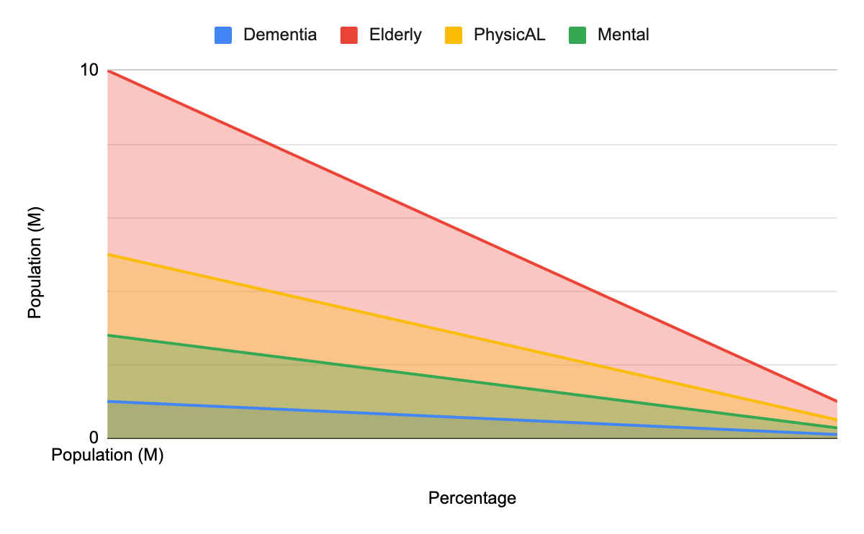
Introduction
UK Population
Overall : Elderly = 68 M : 10M
Rising Demand for Care
Elderly, Dementia, Physical & Mental Difficulties
Competitive Landscape
Internal : High Buyer Power = Higher Cost
External : Significant Rivery
Bupa: Cutting-edge Services
Anchor Hanover: Innovative Techniques
by the end of 2024
Increase Competitiveness Expand Services & Incorporate Tech
50%
28%
+Clients
Personalised Care
Increase Operational Efficiency
10%
+ £ £ £
Source: Office for National Statistics (2023). Profile of the older population living in England and Wales in 2021 and changes since 2011. [online] GOV.UK. Available at : https://www.gov.uk/government/statistics/profile-of-the-older-population-living-in-england-and-wales-in-2021-and-changes-since-2011 [Accessed 27 Jun. 2024].
CCC_Team 2

Slide 5
Introduction
Population Growth:
UK population: 67.85 million by 2024.
9.9% increase by 2036.
Private Sector Growth:
5.56 million SMEs in 2023.
Rising Demand for Care:
Over 10 million seniors.
Dementia cases: 944,000 in 2024 to 1 million by 2030.
Strategic Needs:
Strategic planning and tech integration.
Competitive Landscape:
Competitors: Bupa, Four Seasons, Anchor Hanover, HC-One, Methodist Homes.
High buyer power, significant rivalry.
Key Competitors:
Bupa: Cutting-edge services.
Anchor Hanover: Innovative techniques.
Strategic Goals:
Expand services and incorporate tech.
Increase efficiency and focus on personalised care.
CCC_Team 2

Slide 6
Project Scope & Strategy
Task & Purpose
Suggest tech softwares (AI) to implement,
to
increase the quality of care,
reduce the cost,
prove the quality delivery of care,
make differentiation in the market,
drive the revenue,
and
build a Lidder Care ecosystem for a long run .
Incorporate Tech
Short-term
Increase Operational Efficiency
——— — 5 y rs ————
Mid-term
Personalised Care
+ £ £ £
Long-term
Notes:
To put the scope of this project in one sentence
with the proposed short to long term strategy for Lidder Care:

Slide 7
Overview of Current Systems
Central
Increase Operational Efficiency
Nourish Care
Integrates with Found CRM and Care Planner
Centralizes care plans and documentation
Need for Improvement
Integration Challenges
Efficiency Gaps
Enhanced Functionality
Strategic Need for Improvement
Radar Healthcare
Monitor & Risk
Monitors and manages risks
Provides alerts for incidents
Personnel
Care Planner
Manages staff schedules
Coordinates care tasks
CCC_Team 2

Slide 8
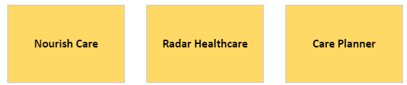
Overview of Current Systems
Nourish Care
Integrates with Found CRM and Care Planner
Centralizes care plans and documentation
Radar Healthcare
Monitors and manages risks
Provides alerts for incidents
Care Planner
Manages staff schedules
Coordinates care tasks
Need for Improvement
Integration Challenges
Efficiency Gaps
Enhanced Functionality
Strategic Need for Improvement
CCC_Team 2

Slide 9
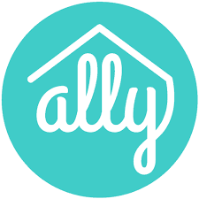
Proposed Systems
Increase Operational Efficiency
Central
Benefits
Nourish Care
Integrates with other systems for a comprehensive & streamline management.
Streamlines Care Coordination and Documentation.
AI-Powered
Ally
Monitor & Risk
Optimizes Resource Allocation for improved health outcomes.
Enhances safety, reduces falls, hospital visits, and improves sleep quality.
AI-Powered
Personnel
Supports Proactive Retention and Enhances Staff Engagement.
Visier People
Provides data-driven insights for efficient staffing and cost management.
CCC_Team 2

Slide 10
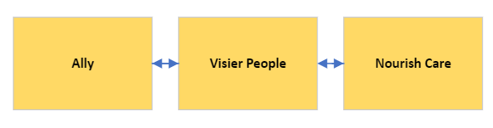
Proposed Systems
Ally: AI-powered Resident Monitoring
Enhances safety, reduces falls, hospital visits, and improves sleep quality.
Optimizes resource allocation for improved health outcomes.
Visier People: Workforce Analytics Platform
Provides data-driven insights for efficient staffing and cost management.
Supports proactive retention and enhances staff engagement.
Nourish Care: Central Care Management
Streamlines care coordination and documentation.
Integrates with CRM for comprehensive client management.
Benefits:
Enhanced safety, improved efficiency, and superior care coordination.
Optimized staffing, reduced operational costs, and enhanced patient outcomes.
CCC_Team 2

Slide 11
Benefits of Ally
Patients
﻿﻿Enhanced Safety & Care Quality by Al-monitoring & alerts.
﻿﻿63% reduction in bedroom falls ; ﻿﻿56% decrease in hospital visits
﻿﻿Better overall health outcomes and quality of life
AI-Powered
Streamlined Operations & Improved Efficiency by its high integration availability.
﻿﻿Support for evidence-based decision-making
﻿﻿Reduced risks
Improved safety standards
Ally
Monitor & Risk
Managers
Enhanced Effectiveness & Efficiency of Care Delivery by Al-monitoring & alerts.
﻿﻿Tailor care to individual needs
Identify early signs of health issues
﻿﻿Prevention of hospital admissions
﻿﻿Reduced workload
Improved time management
Staffs

Slide 12
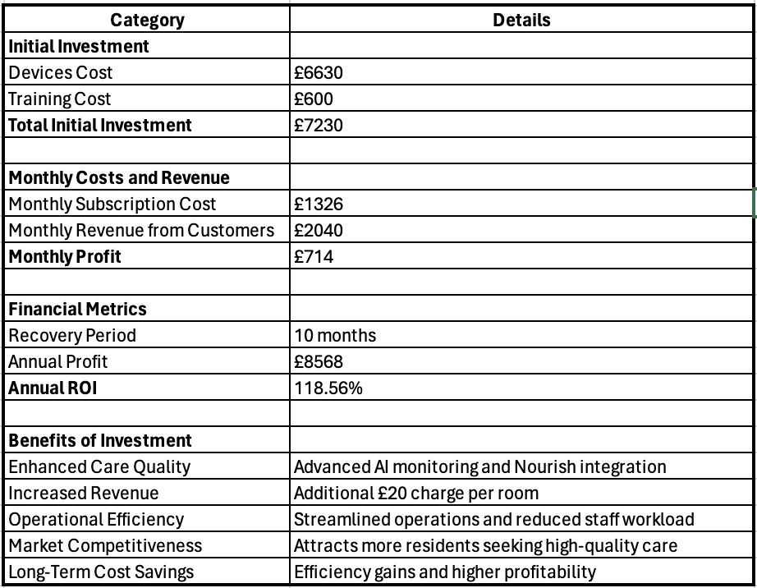
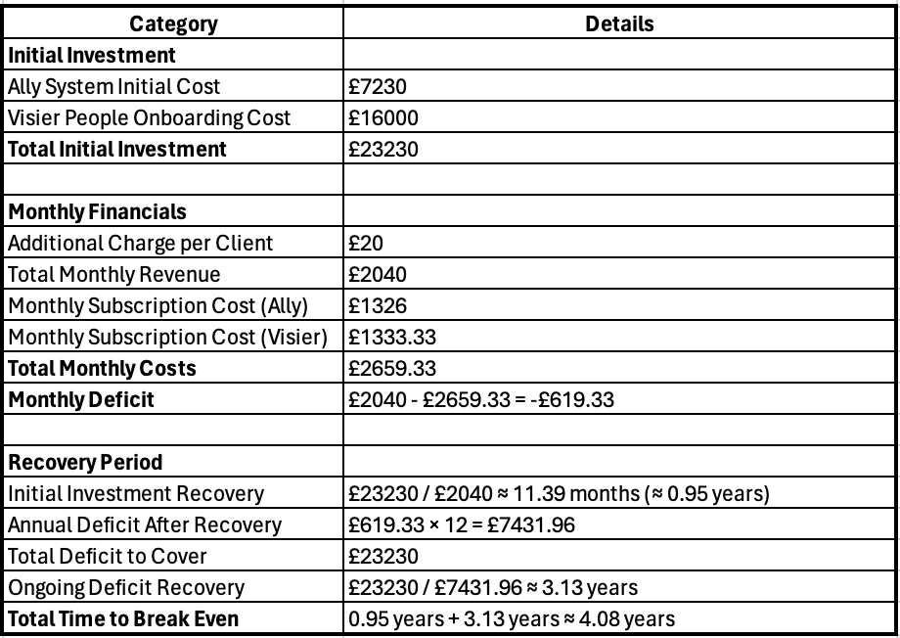
ROI with Ally
ROI with Ally & Visier
CCC_Team 2

Slide 13
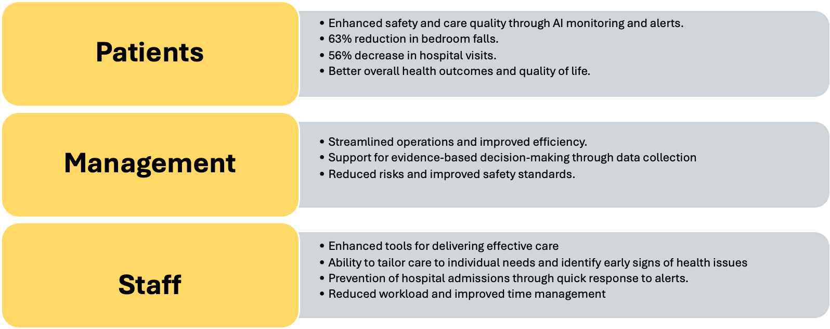
Benefits of Ally

Slide 14
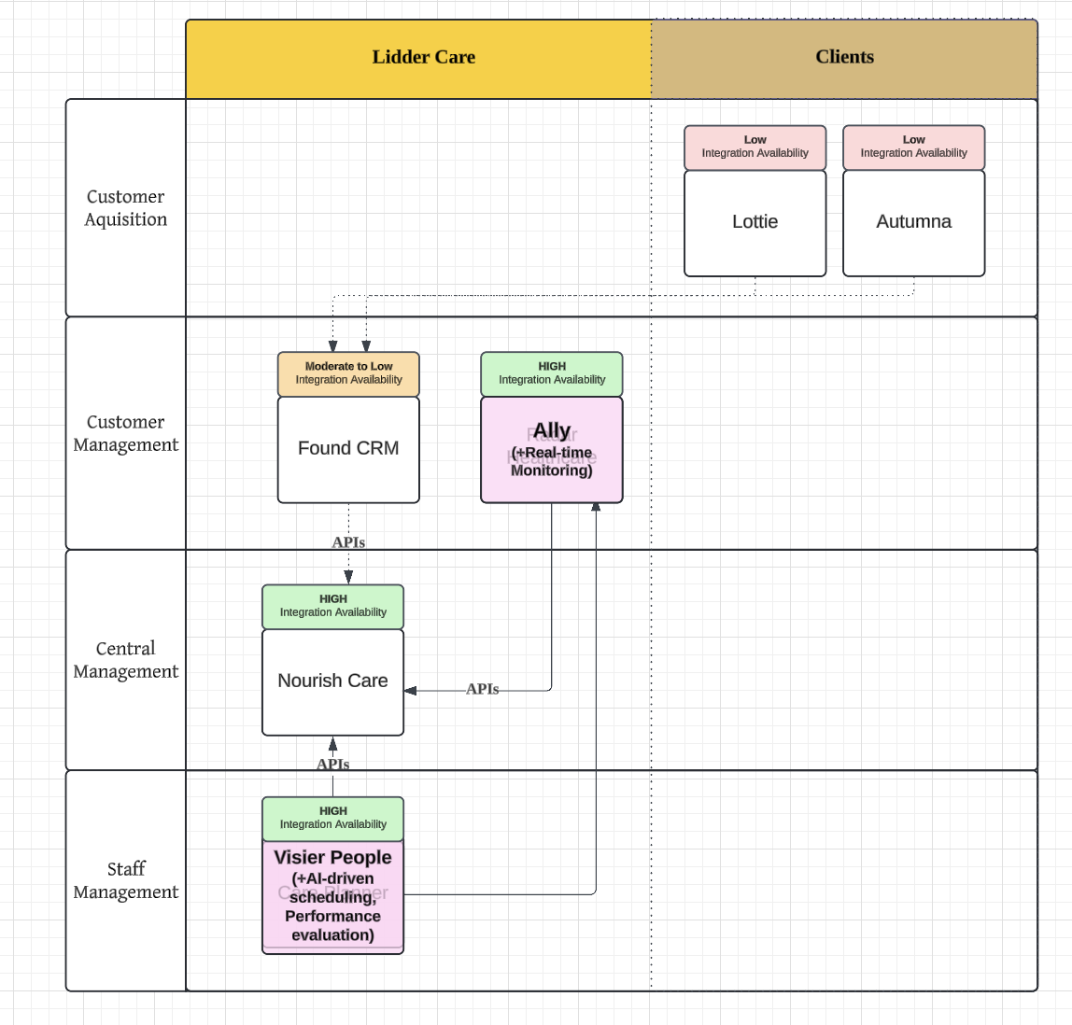
Integration Benefits
High Integrational Availability: APIs (Additional Fee)
= Streamline the Data
For Clients
Real-time Updates
Client: Satisfaction
For Company
User: Convenience, Friendliness
Operation: Efficiency & Accuracy
>>> Overall Service Optimization
For Business: Long-term Benefit
Prove the Quality of Service
Reduce Cost
Automating data exchange
Reducing manual entry
Minimizing errors.
>>> Drive the Revenue & Market Share

Slide 15
Timeline Benefits
 | Short-term (0-6m) | Mid-Term (6-18 months) | Long-Term (18+ months)
Staff | Quick response Reduced workload | Better decision-making | Enhanced skills Job satisfaction
Management | Improved efficiency Better decisions | Attract investment | Business growth
Patients | Timely care Increased safety | Improved health understanding | Better health Quality of life

Slide 16

Timeline Benefits
Short-Term (0-6 months)
Staff: Quick response, reduced workload.
Management: Improved efficiency, better decisions.
Patients: Timely care, increased safety.
Mid-Term (6-18 months)
Staff: Better decision-making.
Management: Attract investment.
Patients: Improved health understanding.
Long-Term (18+ months)
Staff: Enhanced skills, job satisfaction.
Management: Business growth.
Patients: Better health, quality of life.

Slide 17
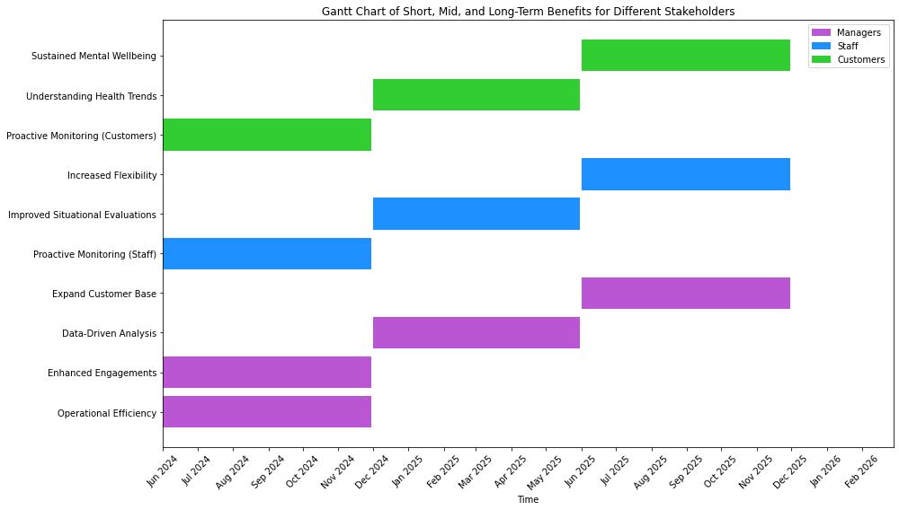
CCC_Team 2

Slide 18
Risk Analysis and Mitigation
TECHNICAL
OPERATIONAL
· Disruption to Daily Operations
o Risk: Transition disrupts care and productivity.
> Mitigation: Plan phased implementation, provide training, ensure technical support.
· System Downtime
o Risk: Impact of downtime on care services.
> Mitigation: Establish backup systems, SLAs with vendors for high availability.
· System Integration Challenges
o Risk: Compatibility issues and data migration challenges.
> Mitigation: Conduct assessments, ensure API integration, pilot tests.
· Data Security and Privacy
o Risk: Increased risk of data breaches.
o Mitigation: Implement encryption, ensure GDPR compliance, regular security audits.
FINANCIAL
HR
· Cost Overruns
o Risk: Unforeseen expenses.
> Mitigation: Detailed budget with contingencies, cost-benefit analyses, fixed-price contracts.
· ROI Uncertainty
o Risk: Expected ROI may not be realized.
> Mitigation: Set performance metrics, monitor progress, adjust based on insights.
· Staff Resistance to Change
o Risk: Resistance due to unfamiliarity or workload.
> Mitigation: Engage staff early, provide training, highlight benefits.
· Skill Gaps
o Risk: Staff may lack necessary skills.
> Mitigation: Invest in training programs, hire skilled personnel.

Slide 19
Conclusion
Strategic Integration
Key Benefits
Competitive Edge
Implement Nourish Care, Ally, and Visier People.
Enhance staff management, operational efficiency, and care quality
Simplify processes, lower response times, and optimize staffing.
Break-even in 4.08 years, with significant financial returns.
Maintain market leadership in innovative care
Meet the needs of an aging population

Slide 20
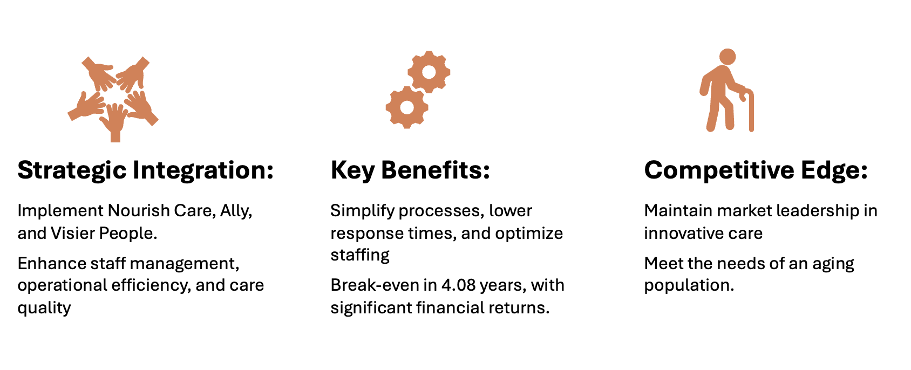
Conclusion

Slide 21
Thank You!
Lidder Care: Team 2
Notes:
Hi, everyone. This is Team 2.
I am Chia-Yu, alongside my colleagues Malaina & Roshni.
We are going to proposed
a system integration solution
to enhance service quality &
operational efficiency
for Lidder Care.

